Slide 1
FIFA World Cup

Slide 2
Objective:
With FIFA being in the blood as many people of the world. The tasked is to tell the story of unsung analysts who put great efforts to provide accurate data to answer every question of fans.
The FIFA World Cup is a global football competition contested by the various football-
playing nations of the world. It is contested every four years and is the most prestigious and important trophy in the sport of football.
The World Cups dataset show all information about all the World Cups in the history,
while the World Cup Matches dataset shows all the results from the matches contested
as part of the cups.

Slide 3
Dataset :
World Cups dataset
World Cup Matches dataset
World Cup Players dataset

Slide 4
Data Validation and Data Transformation :
Change data type of columns in world cup matches dataset, world cups and world cup players dataset.
Replaced values of wrong spelling in a data with a correct spelling.
Merged column ‘home team name’ and column ‘away team name’ with custom delimiter “vs” and named new column as ‘matches’.
Group By ‘year’ and ‘home team name’ column by ‘home team goals’ column and Group By ‘year’ and ‘away team name’ column by ‘away team goals’ column.
Create ‘outcome’ column by merging ‘home team goals’ and ‘away team goals’ column with delimiter ‘-’.

Slide 5
Data Insertion in Database:
Table creation :- Table name “World Cups “,” World Cup Matches” and “World Cup Players” is created in the database for inserting the files. If the table is already present then new files are inserted in the same table.
Insertion of files in the table - All the files in the given Google drive folder are inserted in the above-created table. If any file has invalid data type in any of the columns, the file is not loaded in the table

Slide 6
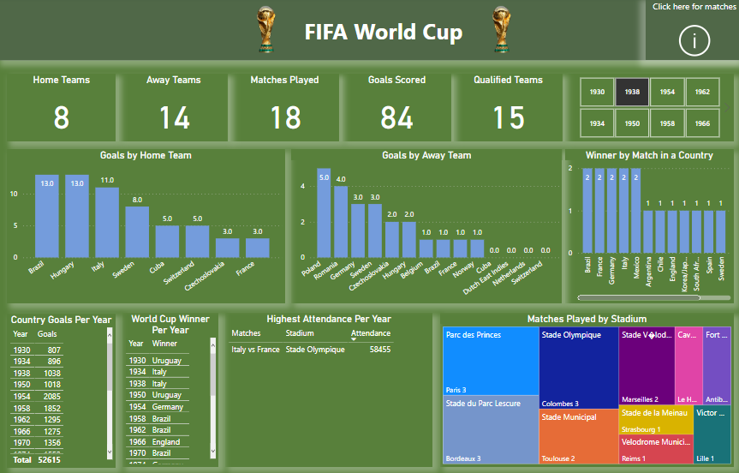
1. Overview of FIFA World Cup:
◼ Home Teams: The visual show the number of home teams.
◼ Away Teams: The visual show the number of away teams.
◼ Matches Played: The visual show the number of matches played.
◼ Goals Scored: The visual show the number of goals scored.
◼ Qualified Teams: The visual show the number of Qualified teams.
◼ Year Slicer: Slicer consists of Years of world cup.
◼ Goals by Home Teams: The visual show the number of goals made by home teams.
◼ Goals by Away Teams: The visual show the number of goals made by away teams.
◼ Winners by Match in a Country: Winners by country where matches played.
◼ Country Goals per Year: The visual show the number of goals by year.
◼ World Cup Winner per Year: The visual show the winner by year.
◼ Highest Attendance Per Year: The visual show the highest attendance.
◼ Matches Played by Stadium: The visual show the number of matches played by stadium and city.

Slide 7
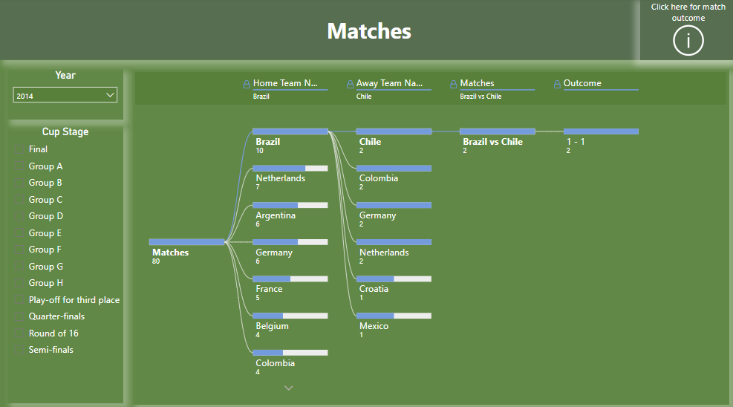
2. Matches Played in FIFA World Cup :
◼ Year Slicer: Slicer consists of Years of world cup.
◼ Cup Stage Slicer: Slicer consists of cup stages of world cup.
◼ Decomposition tree: The visual show all the matches played by teams with their goal scored.

Slide 8
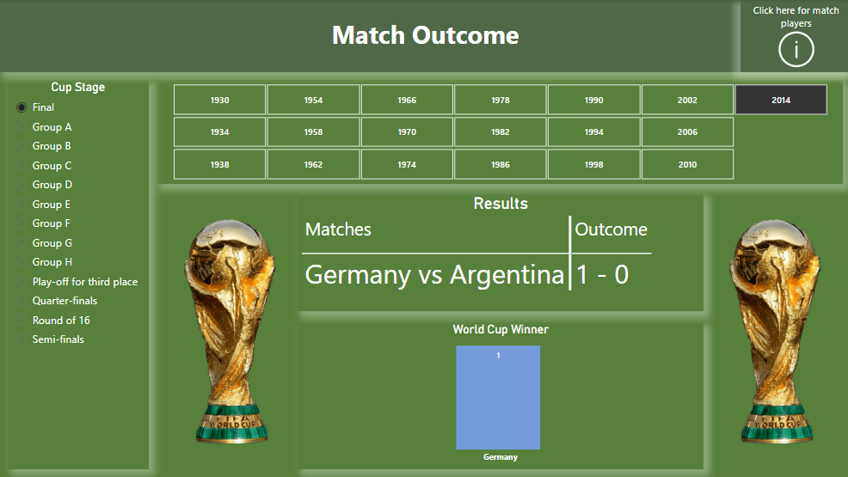
3. Outcome of FIFA World Cup:
◼ Year Slicer: Slicer consists of Years of world cup.
◼ Cup Stage Slicer: Slicer consists of cup stages of world cup.
◼ Results: The visual show the result of winning match with goals scored.
◼ World Cup Winner: The visual show the winning team name.

Slide 9
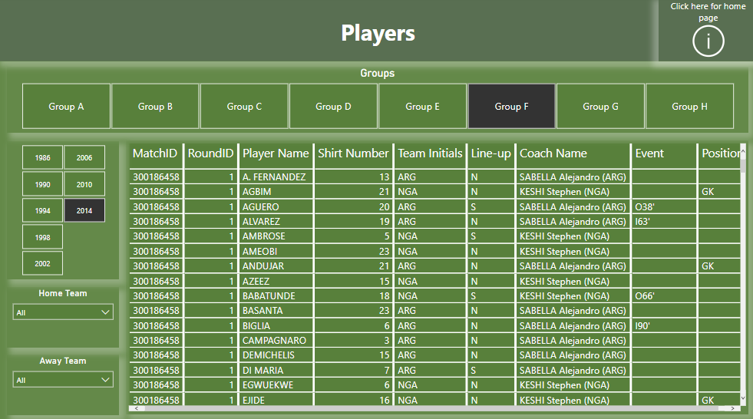
4. Players of FIFA World Cup:
◼ Groups: Slicer consists of Groups of stages of world cup.
◼ Year Slicer: Slicer consists of Years of world cup.
◼ Home Team: Slicer consists of home team name.
◼ Away Team: Slicer consists of away team name.
◼ Player Details: The visual show all the details related to players of a world cup.

